Slide 1

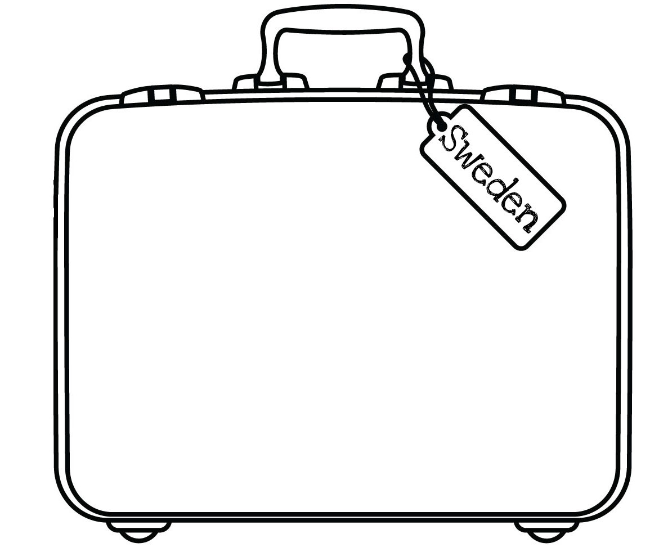

Slide 2
¿Cuándo? – When?
Normalmente – Normally
A veces - Sometimes
A menudo - Often
Cada año – Each year
Siempre – Always
Generalmente - Generally

Slide 3

voy a Londres voy a Cornualles
Países y Ciudades

Slide 4

voy a Escocia
Países y Ciudades

Slide 5

voy a Gales
Países y Ciudades

Slide 6

voy a Irlanda
Países y Ciudades

Slide 7
voy a España
Países y Ciudades

Slide 8
voy a Francia
Países y Ciudades

Slide 9

voy a Alemania
Países y Ciudades

Slide 10
voy a Italia
Países y Ciudades

Slide 11

vamos a Grecia
Países y Ciudades

Slide 12

vamos a Los Estados Unidos
Países y Ciudades

Slide 13





Normally
I
go
Sometimes
Often

Slide 14
¿Por qué? – Why?
porque es divertido – because it’s fun
porque es rápido – because it’s quick
sin embargo (no) es cómodo – however it’s (not) comfortable
pero es lento – but it’s slow
pero es caro – but it’s expensive
es más barato que – it’s cheaper than
es menos rápido que – it’s less quick than

Slide 15
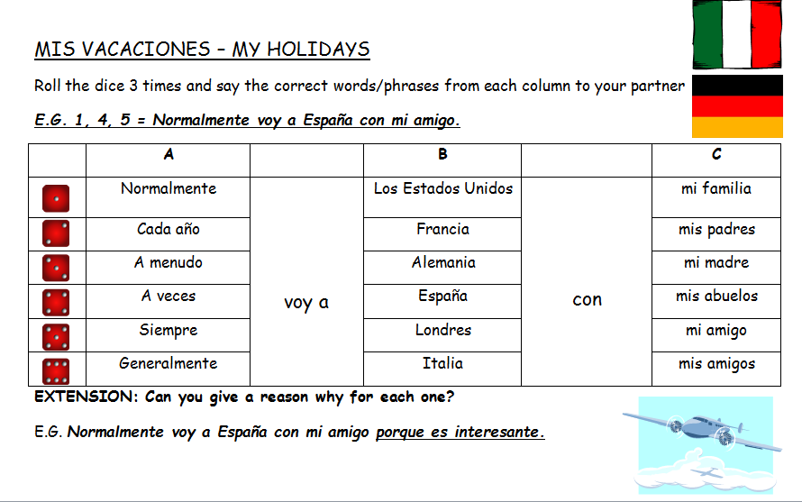
Notes:
Can be done as a class or in pairs. Students have to say the sentence for each slide. Easy – using their vocabulary sheet to help them. Medium – without. Difficult – have to had some extra information eg. con mi familia.

Slide 16
ESCRIBIR / WRITING
Write out the sentences for these:
1,3,6
2,4,5
6,5,2
4,1,3
3,6,4
5,2,1
EXTENSION:
Try to give reasons why.
Can you give another person’s opinion?
Notes:
Can be done as a class or in pairs. Students have to say the sentence for each slide. Easy – using their vocabulary sheet to help them. Medium – without. Difficult – have to had some extra information eg. con mi familia.

Slide 17
STARTER / PARA EMPEZAR
Choose 3 sentences from last lesson
Translate them into English
Extension: write some of your own in Spanish

Slide 18
Fácil / Easy
Normally I go to France by ferry but it’s slow.
Each year I go to Spain by train because it is cheap.
Each Summer we go to New York by plane because it’s fun.
When I go on holiday normally I go to Scotland by car because it’s comfortable.
Difícil / Difficult
Each Summer we go to Cornwall by train but it’s very expensive.
Normally I go to France by plane because it’s quicker than going by ferry.
Each year I go to Germany with my family. We go by plane because it’s more comfortable than going by car.
Sometimes we go to Scotland by train but this year we are going to go by car because it’s more comfortable.
Extension
Now write a few of your own sentences about your holidays.
Include: where you go, who with, how you get there, why and a comparison.

Slide 19
V E C P E C
V A L E U E A P E M R
V A F E F P E M B
V A E E T S E E M L

Slide 20

Las Vacaciones
viernes el 11 de octubre
Objetivo: To learn vocabulary for talking about holidays and practise comparing ideas.
Para empezar:
5 minutos para repasar el vocabulario

Slide 21
Francia
España
Londres
amiga.
familia.
novio.
Normalmente voy de vacaciones a
con mi
tren
barco
avión
barato
rápido
cómodo
Viajamos en
porque es más
ferry.
autocar.
coche.
Sin embargo el año que viene mis amigos y yo vamos a ir a
Francia
Alemania
Los Estados Unidos
que ir en
hacer ciclismo.
esquiar.
visitar monumentos.
para

Slide 22
Using the following questions and the vocabulary on your grid, see how long you can speak in Spanish with your partner about your holidays.
¿Adónde vas de vacaciones? Where do you go on holiday?
¿Cuándo? When?
¿Con quién vas? Who do you go with?
¿Cómo vas? How do you get there?
¿Por qué? Why?
¿Te gusta…? Do you like…?

