Slide 1
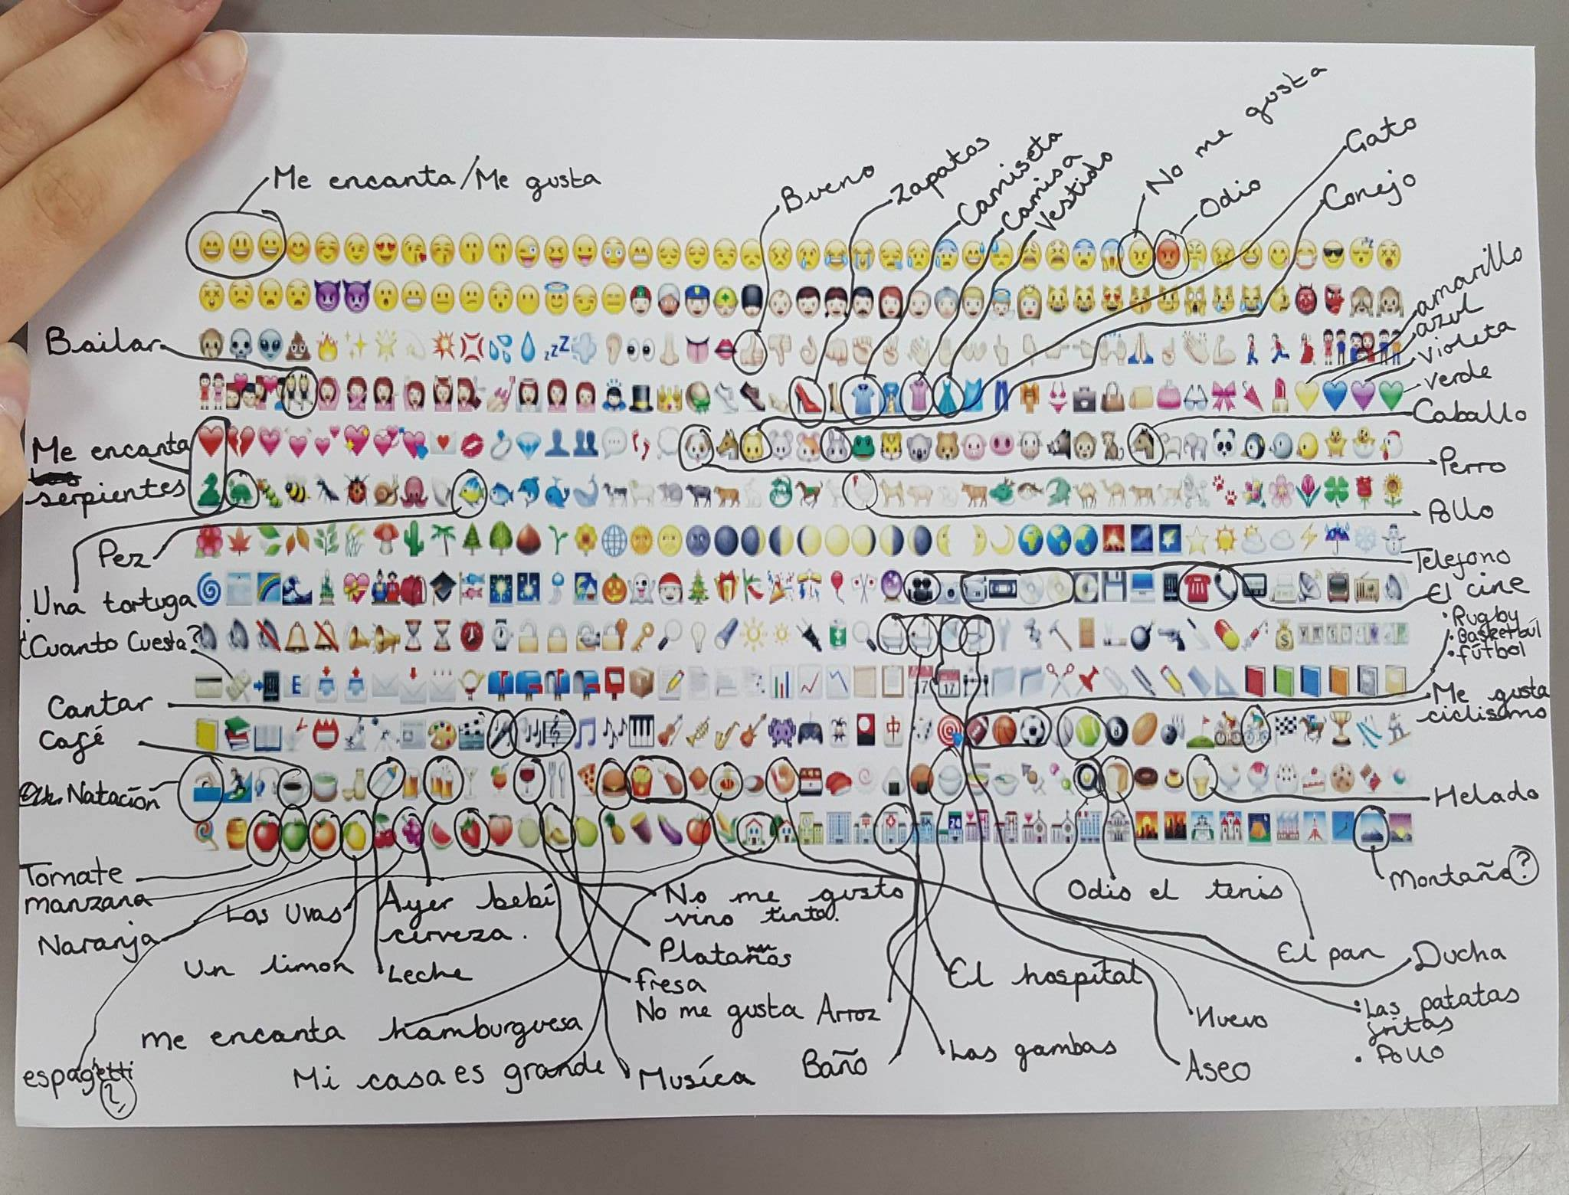
STARTER CHALLENGE: How many words / phrases can you think of in French or Spanish to describe the emojis? Work in pairs to annotate your sheet.
Example:

Slide 2
An A-Z of Ideas for the Language Classroom
Dannielle Warren
Wednesday 20th September 2017

Slide 3
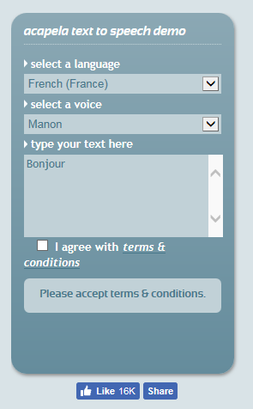
A
Converts text to speech
Pronunciation
Remember to select the
correct language though!
http://www.acapela-group.com/

Slide 4
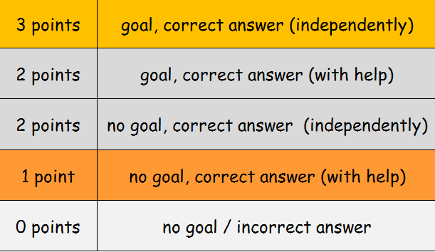
B
http://morganmfl.weebly.com/mfl-ideas/mfl-beer-pong

Slide 5
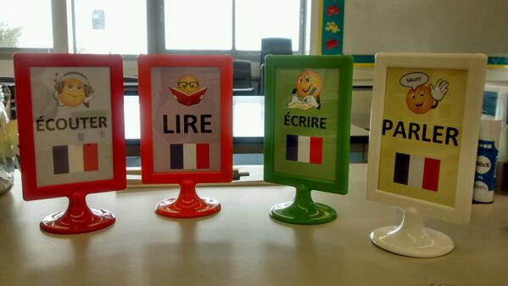
C
Pros
Cons
Very little teacher input needed if planned well
Pupil independence and team work
A range of skills can be used
Can be quite a lot of work beforehand
Better with FLA
Can be tricky to monitor some activities → speaking
http://morganmfl.weebly.com/mfl-ideas/carousel-stations

Slide 6
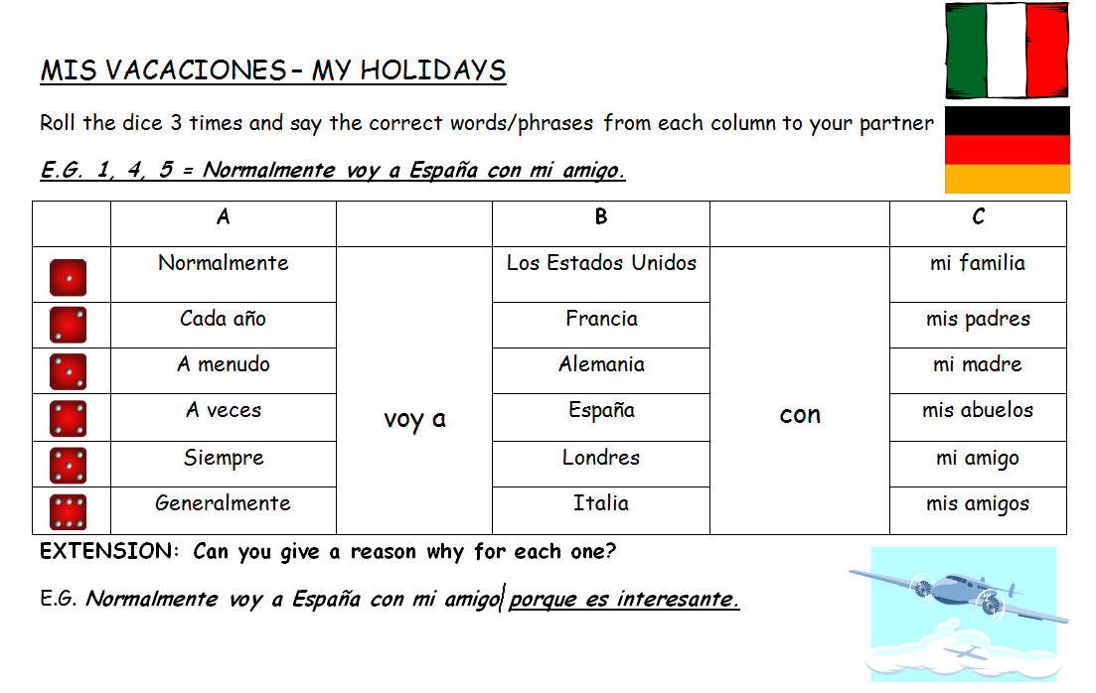
D

Slide 7
E
European Languages Week
Resources: http://edl.ecml.at/
Launch of Duolingo competition (staff and pupils)
and lunchtime Duolingo club
–Lots of resources kindly shared by David Shanks here:
https://www.dropbox.com/sh/ymm07nf85cfh3wr/AACnz6ota-cknRU9EBlAVpQka?dl=0
Launch of German Club
Themed lunches and music played in the hall
Bake Off Competition
‘Why Learn A Language?’ Poster Competition

Slide 8
F
Nice starter activity based on app
https://www.tes.com/teaching-resource/4-pictures-1-word-french-6328768

Slide 9
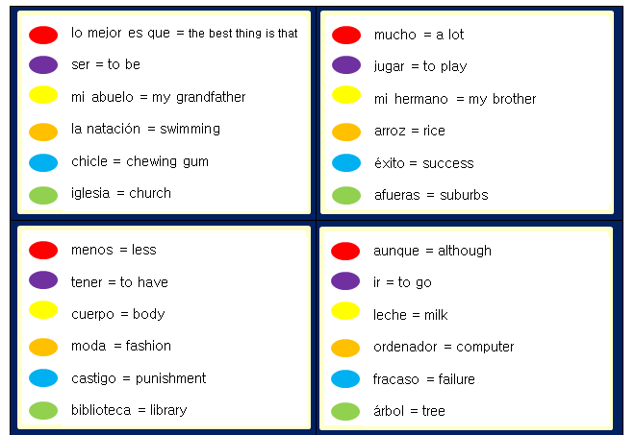
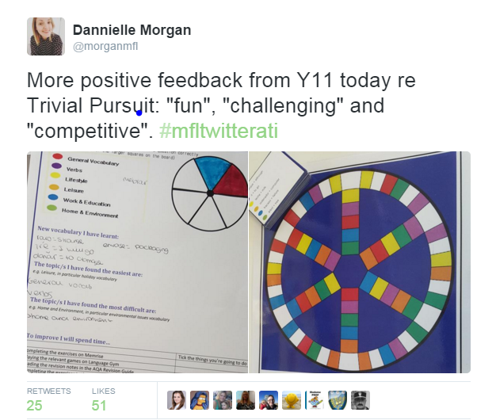
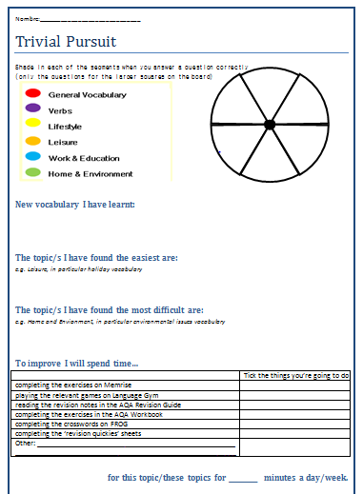
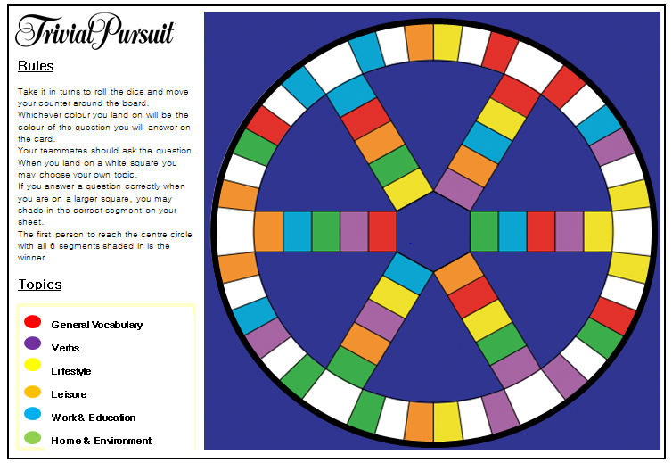
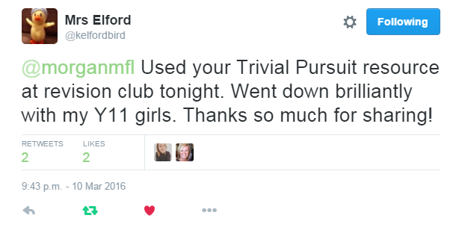
G

Slide 10
G
Trivial Pursuit
Spanish: http://morganmfl.weebly.com/mfl-ideas/gcse-spanish-trivial-pursuit
German: https://www.tes.com/teaching-resource/trivial-pursuit-german-year-11-revision-aqa-11276077
(edited and shared by Spenny2 on TES)

Slide 11
H
One student sits on the ‘hot seat’ and the rest of the class asks them questions relating to today’s lesson. If they get a question wrong they must sit back in their own seat. The person in the seat at the end of the lesson is the winner.

Slide 12
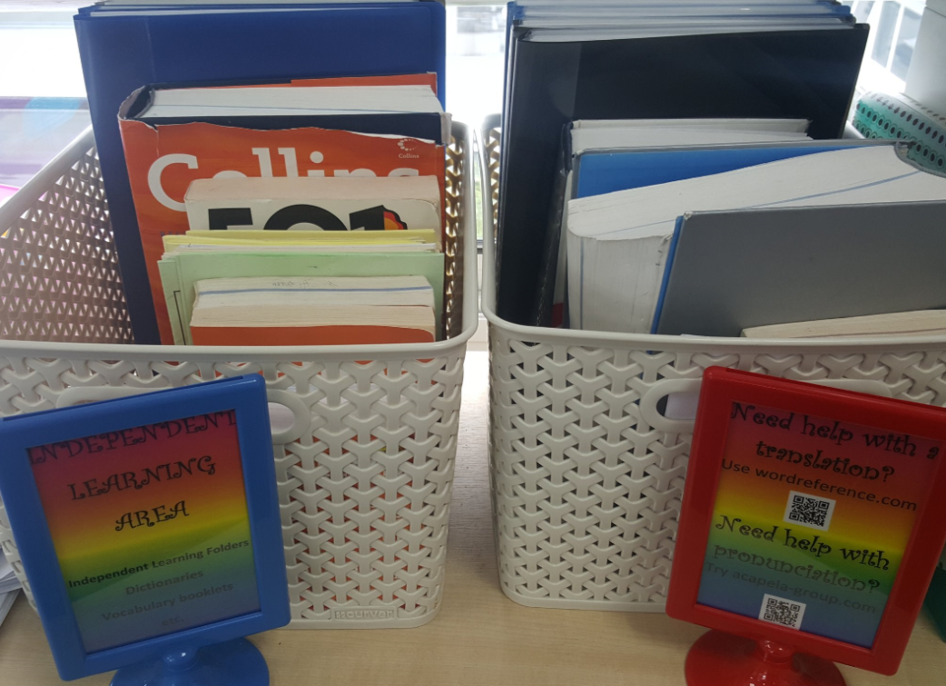
I
French: https://www.tes.com/teaching-resource/french-independent-learning-folder-6424089
Spanish: https://www.tes.com/teaching-resource/spanish-independent-learning-folder-6424090

Slide 13
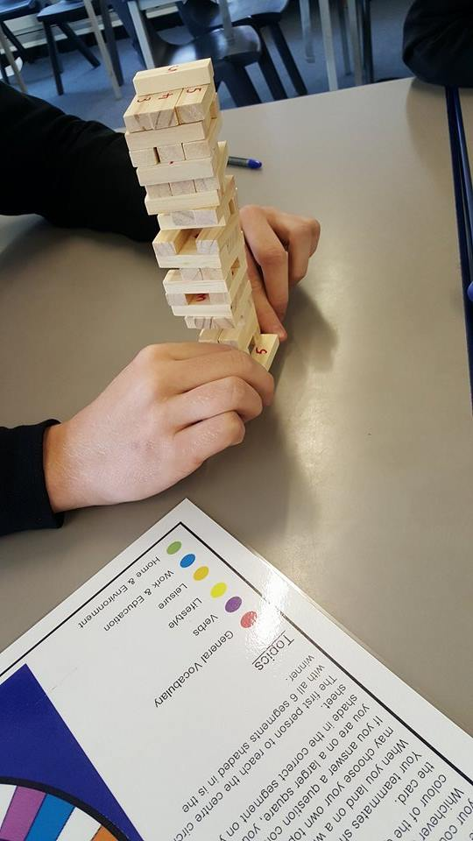
J

Slide 14
K
https://www.powtoon.com/online-presentation/g3P6MPlDXu4/kahoot/
https://kahoot.com/
MorganMFL Blogspot: http://morganmfl.blogspot.co.uk/2014/06/kahoot.html

Slide 15
L
Created by Gianfranco Conti (@gianfrancocont9)
– also see his resources on TES
https://www.language-gym.com/#!/

Slide 16
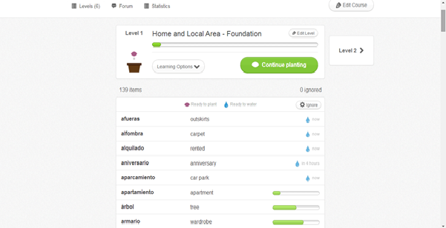
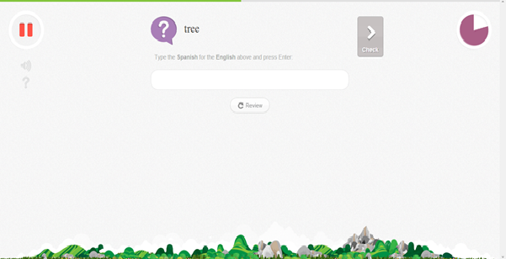
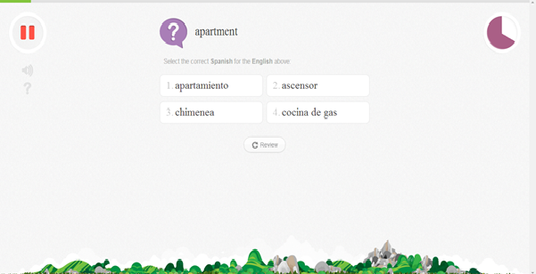
M
Set courses for your different classes
Memrise teaches the vocabulary, then tests them on it with games

Slide 17
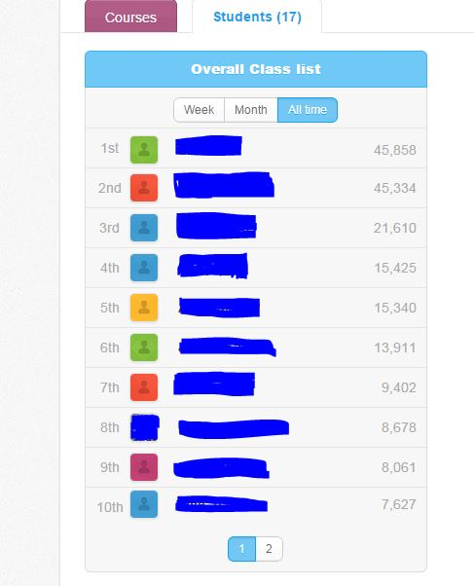
M
Monitor weekly, monthly and all time progress for all students
Check leader boards – top 3 win prizes / certificates each week

Slide 18
M
Blogspot – About Memrise: http://morganmfl.blogspot.co.uk/2014/04/memrise.html
Weebly – Step-By-Step Guide to Memrise:
http://morganmfl.weebly.com/mfl-ideas/memrise
Weebly – Memrise Certificates:
http://morganmfl.weebly.com/mfl-ideas/memrise-certificates

Slide 19
M
Year 10 - When asked what helps them progress:
Feedback from a Year 11 student:

Slide 20
M
Positive email home for a Year 8 student:
Parent’s response:
‘I am amazed by how much time and effort she has put in to working through the courses on Memrise (including starting a GCSE course - amazing!) Well done and keep up the hard work!’
‘Thank you so much for your message, it is so good to hear that all her hard work is recognised.***** is certainly enjoying her Spanish and the Memrise, I think she is spurred on to try and beat one of her classmates too!’

Slide 21
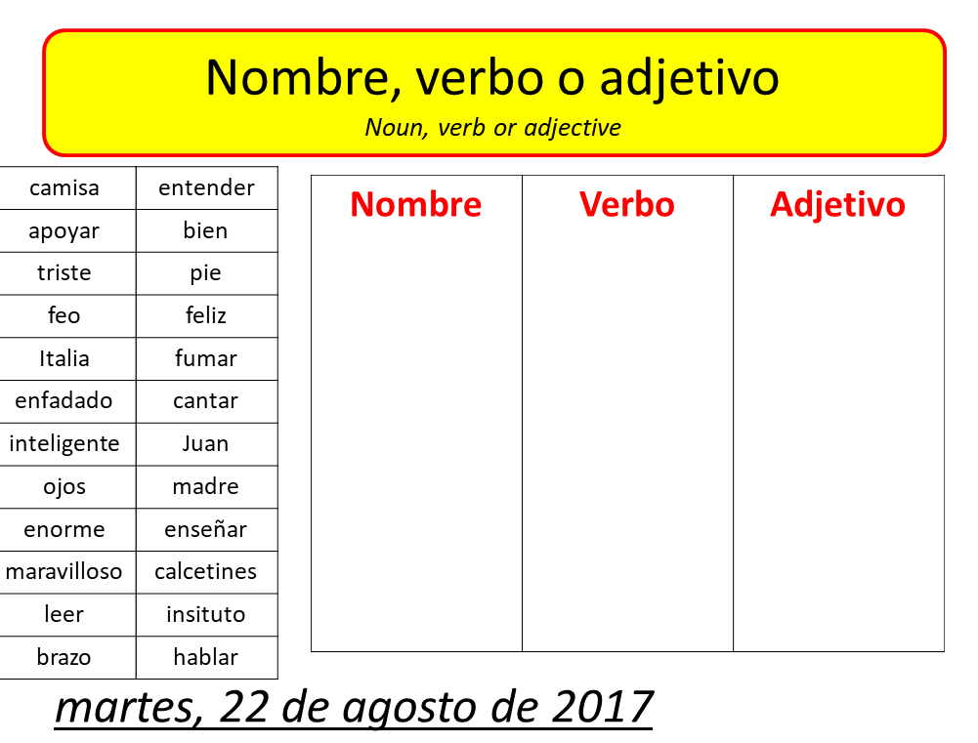
N

Slide 22
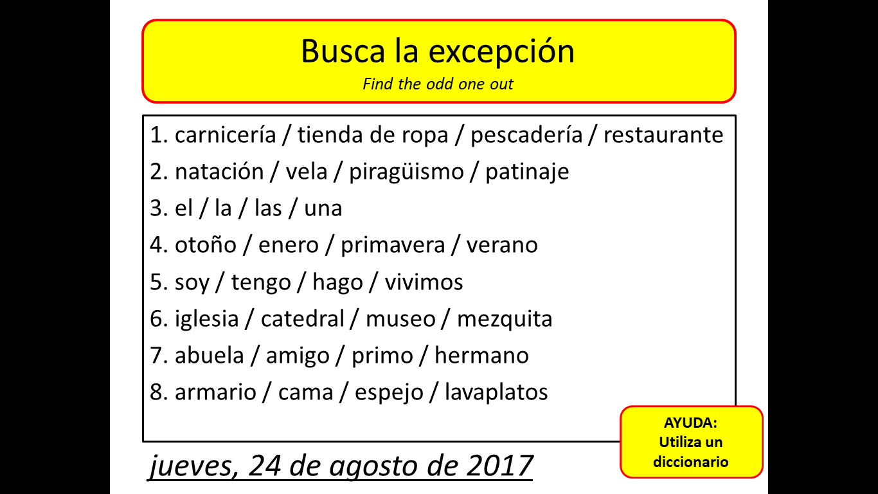
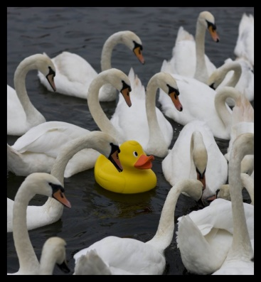
O
Write lists of words on the board in the target language. Students have to decide which is the odd one out from each set and why.

Slide 23
P
Create tutorials and share with pupils via VLE
Could be used for Flip Learning -> students learn independently at home then practise this in lesson with teacher guidance
Pupils could create their own
https://www.powtoon.com

Slide 24
Q
Everyone has a piece of paper with a sentence and the translation underneath.
Walk around the room reading your sentence to other people. The other person translates. You then do the same with their card. If both people translate each others’ cards correctly you can swap.
Count the amount of times you have exchanged papers. Can you get more than 10?

Slide 25
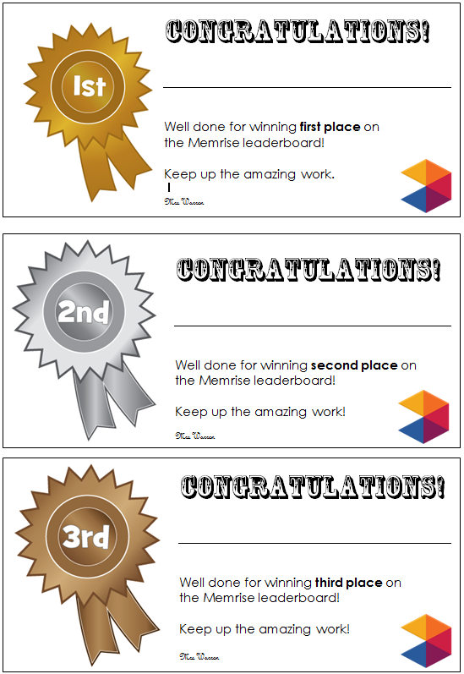
R

Slide 26
S
Tips!
Make sure your personal accounts and teacher accounts are separate.
Keep personal accounts private.
Be aware of using work related social media too much – don’t forget to switch off and have time away from work – it can become addictive!
Twitter
@joedale #mfltwitterati
@nowMrsBeattie
@MissMeyMFL
@mrsscottmfl
@reebekwylie
@spsmith45
@JessicaLundx
@_Hannah_Edwards
Facebook
Global Innovative Language Teachers
MFL Teachers’ Lounge
MFL Resources and Ideas
Secondary MFL Matters
MFL Fun

Slide 27
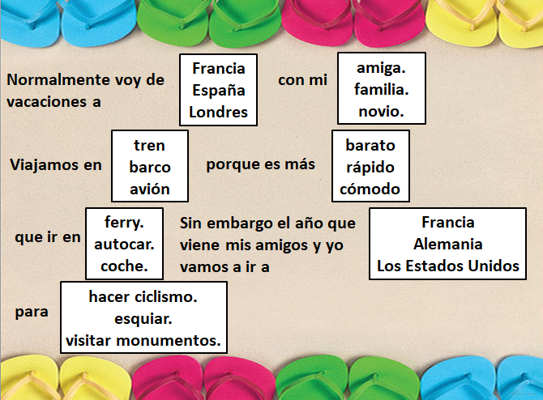
T
Students take it in turns to guess the correct option for each
If they get it wrong someone else reads from the beginning
Winner is the one who gets to the end with all correct answers
Can be done in small groups or as a class

Slide 28
U
Ashcombe School: http://www.ashcombe.surrey.sch.uk/legacy/Curriculum/modlang/
index_teaching.htm
Menti:
https://www.menti.com/
QR Code Generator:
https://www.qrstuff.com/
Rebecca Wylie’s blog:
http://srswopshop.blogspot.co.uk/
Word Reference:
http://www.wordreference.com/
A full list of links can be found at:
http://morganmfl.weebly.com/links.html

Slide 29
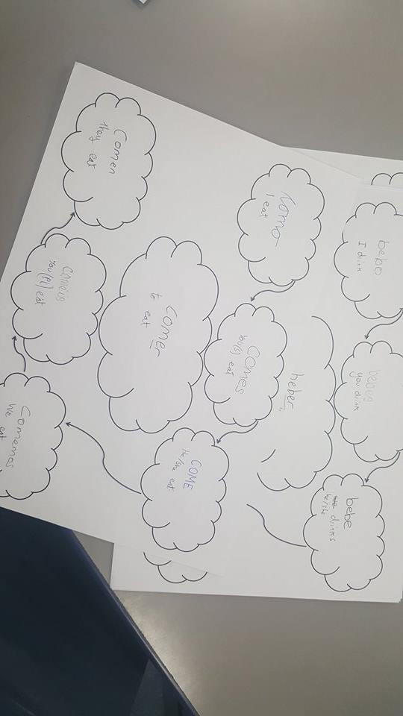
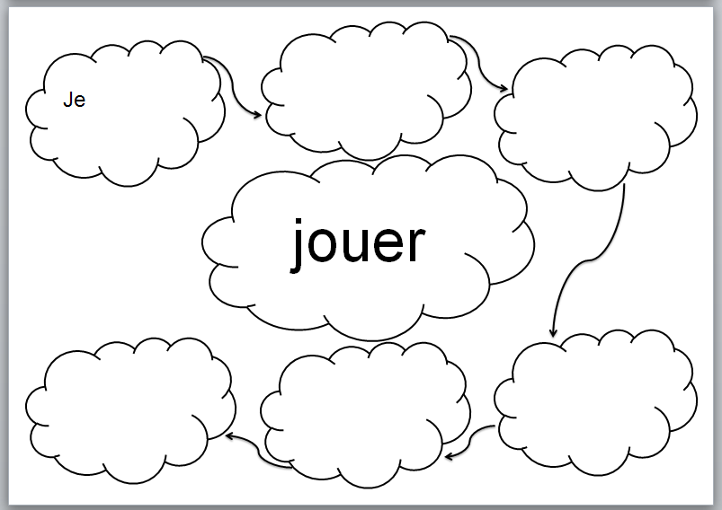
V
More information here:
Idea from Deborah Bassnett at St Pius School:
http://morganmfl.weebly.com/mfl-ideas/verb-clouds

Slide 30
W
Creative homework
Review of vocabulary from certain topic
To teach pupils how to do a presentation without reading from a sheet and just using prompts
www.wordle.net

Slide 31
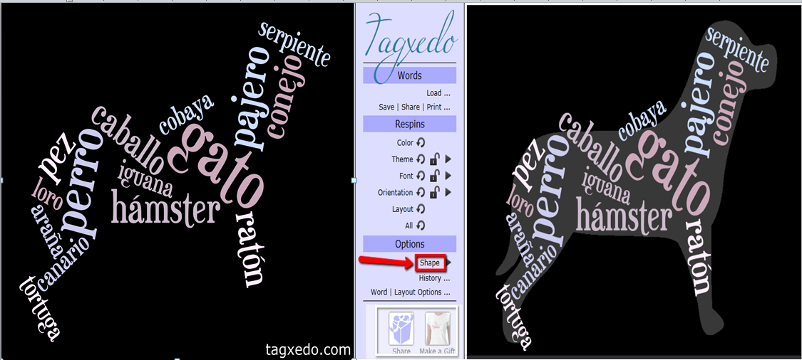
X
Similar to Wordle
http://www.tagxedo.com/

Slide 32
Y
French Videos:
5 a day French:
https://www.youtube.com/watch?v=KVhfIgghOPw
https://www.youtube.com/watch?v=y47eSlLSxa0
Spanish Videos:
https://www.youtube.com/user/SrMara
https://www.youtube.com/watch?v=80O0q9e-mHQ
Kevin y Karla y La Banda: https://www.youtube.com/user/kvnvasquez

Slide 33
Z
Get plenty of rest
Try to maintain a healthy work life balance – e.g. at least one day and evening off a week
Martyn Reah (@MartynReah)
#Teacher5ADay
https://martynreah.wordpress.com
Mrs Humanities (@MrsHumanities)
#Teacher5ADayBuddyBox
https://mrshumanities.com/teacher5day-wellbeing-buddy-box/

Slide 34
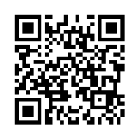
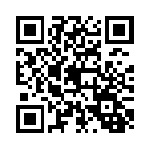
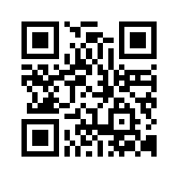
Twitter
https://twitter.com/morganmfl
Facebook
https://www.facebook.com/morganmfl/
Weebly Blog
morganmfl.weebly.com

