Slide 1
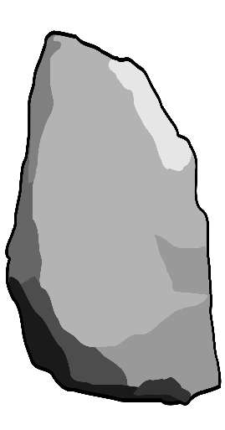
In my free time I prefer to listen to music alone in my bedroom because it makes me happy and it relaxes me.
Every day I love to watch the news because for me it’s important, however it makes me sad sometimes.
From time to time I like to watch soaps although sometimes they get on my nerves because they are unrealistic.
When I have time I’m interested in reading fashion magazines because I love to buy new clothes.
Often I like watch horror films at the cinema with my cousin even though they scare me.
LO: TBAT implement exam strategies IOT complete exam style questions at your target level, covering all four language skills, using a range of language and time frames appropriate to your target grade.
porque no son realistas. | sin embargo me hacen triste a veces. | comprar nueva ropa. | aunque me dan miedo. | y me relaja.
son importantes | me molestan | ya que me hace felíz | con mi primo | dado que me encanta
aunque a veces | solo en mi dormitorio | revistas de moda | ya que para mí | en el cine
me interesa leer | me mola ver películas de terror | me encanta ver las noticias | prefiero escuchar música | me chifla ver las telenovelas
En mi tiempo libre | Todos los días | De vez en cuando | Cuando tengo tiempo | A menudo
Notes:
Rock Climbers – Translation activity
Students work their way up the grid translating the sentence – could be done as a spoken or a written activity

Slide 2
In my free time I prefer to listen to music alone in my bedroom because it makes me happy and it relaxes me.
Every day I love to watch the news because for me it’s important, however it makes me sad sometimes.
From time to time I like to watch soaps although sometimes they get on my nerves because they are unrealistic.
When I have time I’m interested in reading fashion magazines because I love to buy new clothes.
Often I like watch horror films at the cinema with my cousin even though they scare me.
LO: TBAT implement exam strategies IOT complete exam style questions at your target level, covering all four language skills, using a range of language and time frames appropriate to your target grade.
porque no son realistas. | sin embargo me hacen triste a veces. | comprar nueva ropa. | aunque me dan miedo. | y me relaja.
son importantes | me molestan | ya que me hace felíz | con mi primo | dado que me encanta
aunque a veces | solo en mi dormitorio | revistas de moda | ya que para mí | en el cine
me interesa leer | me mola ver películas de terror | me encanta ver las noticias | prefiero escuchar música | me chifla ver las telenovelas
En mi tiempo libre | Todos los días | De vez en cuando | Cuando tengo tiempo | A menudo
Notes:
Rock Climbers – Translation activity ANSWERS
Students work their way up the grid translating the sentence – could be done as a spoken or a written activity

