Slide 1
Vocabulary test = one per fortnight as decided by your class teacher
Write your answers at the back of your pink books
Marks /20
Revise vocabulary in your booklet by copying out over and over until you know it off by heart
Create your own flashcards and ask a friend or family member to test you on the spellings
Use Memrise (your teacher will help you get set up if you aren’t already)
20/20 = HP 16/20 = MFL point Underperforming = Come back at lunchtime

Slide 2
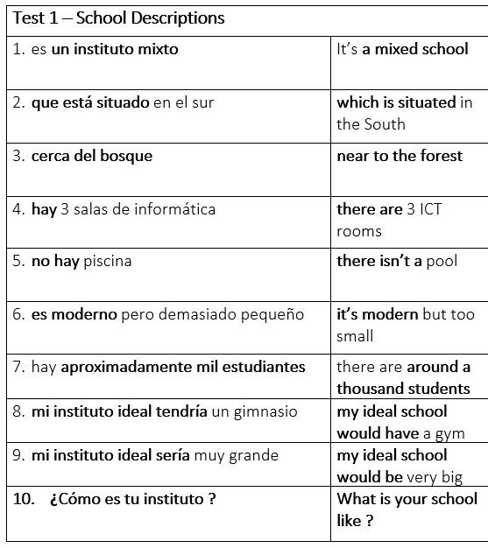
HIGHER
Write numbers 1-10 at the back of your yellow book, then in silence write out the Spanish translations

Slide 3
FOUNDATION
Write numbers 1-10 at the back of your yellow book, then in silence write out the Spanish translations of the words in bold.

Slide 4
ANSWERS
Now swap books with the person next to you and mark their answers.
When you get your book back copy your spellings correctly in green pen.
Write your score on the sheet at the back of your book.
20/20 = house point 16/20 = MFL point Underperforming = Resit at lunch

Slide 5
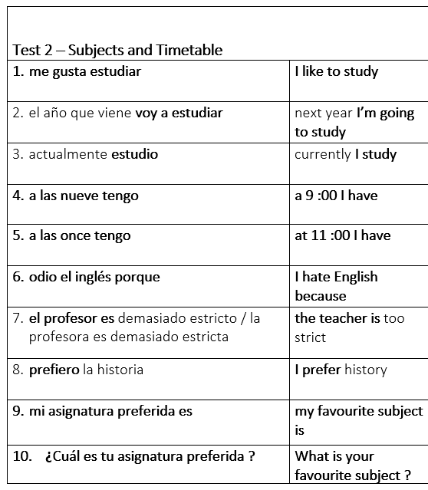
HIGHER
Write numbers 1-10 at the back of your yellow book, then in silence write out the Spanish translations

Slide 6
FOUNDATION
Write numbers 1-10 at the back of your yellow book, then in silence write out the Spanish translations of the words in bold.

Slide 7
ANSWERS
Now swap books with the person next to you and mark their answers.
When you get your book back copy your spellings correctly in green pen.
Write your score on the sheet at the back of your book.
20/20 = house point 16/20 = MFL point Underperforming = Resit at lunch

Slide 8
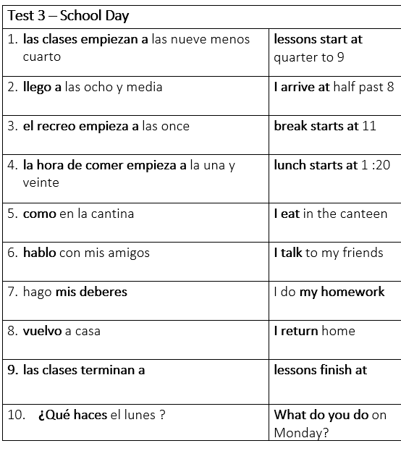
HIGHER
Write numbers 1-10 at the back of your yellow book, then in silence write out the Spanish translations

Slide 9
FOUNDATION
Write numbers 1-10 at the back of your yellow book, then in silence write out the Spanish translations of the words in bold.

Slide 10
ANSWERS
Now swap books with the person next to you and mark their answers.
When you get your book back copy your spellings correctly in green pen.
Write your score on the sheet at the back of your book.
20/20 = house point 16/20 = MFL point Underperforming = Resit at lunch

Slide 11
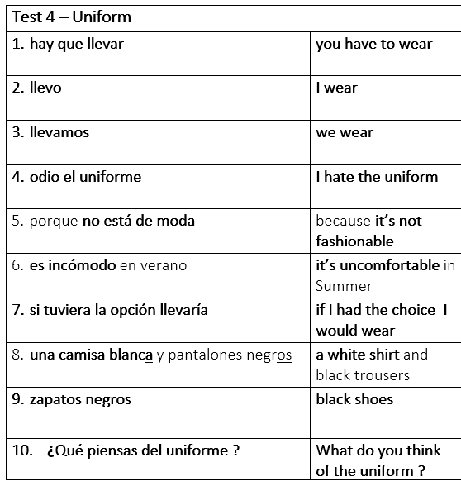
HIGHER
Write numbers 1-10 at the back of your yellow book, then in silence write out the Spanish translations

Slide 12
FOUNDATION
Write numbers 1-10 at the back of your yellow book, then in silence write out the Spanish translations of the words in bold.

Slide 13
ANSWERS
Now swap books with the person next to you and mark their answers.
When you get your book back copy your spellings correctly in green pen.
Write your score on the sheet at the back of your book.
20/20 = house point 16/20 = MFL point Underperforming = Resit at lunch

Slide 14
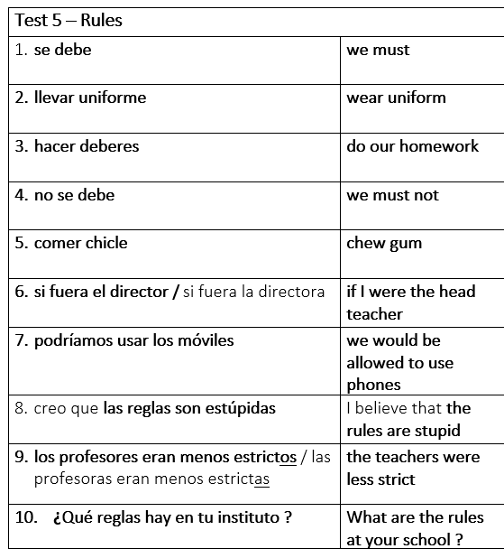
HIGHER
Write numbers 1-10 at the back of your yellow book, then in silence write out the Spanish translations

Slide 15
FOUNDATION
Write numbers 1-10 at the back of your yellow book, then in silence write out the Spanish translations of the words in bold.

Slide 16
ANSWERS
Now swap books with the person next to you and mark their answers.
When you get your book back copy your spellings correctly in green pen.
Write your score on the sheet at the back of your book.
20/20 = house point 16/20 = MFL point Underperforming = Resit at lunch

Slide 17
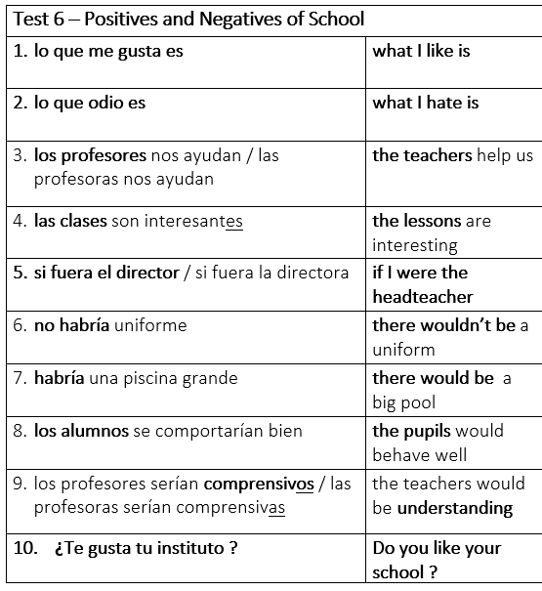
HIGHER
Write numbers 1-10 at the back of your yellow book, then in silence write out the Spanish translations

Slide 18
FOUNDATION
Write numbers 1-10 at the back of your yellow book, then in silence write out the Spanish translations of the words in bold.

Slide 19
ANSWERS
Now swap books with the person next to you and mark their answers.
When you get your book back copy your spellings correctly in green pen.
Write your score on the sheet at the back of your book.
20/20 = house point 16/20 = MFL point Underperforming = Resit at lunch

Slide 20
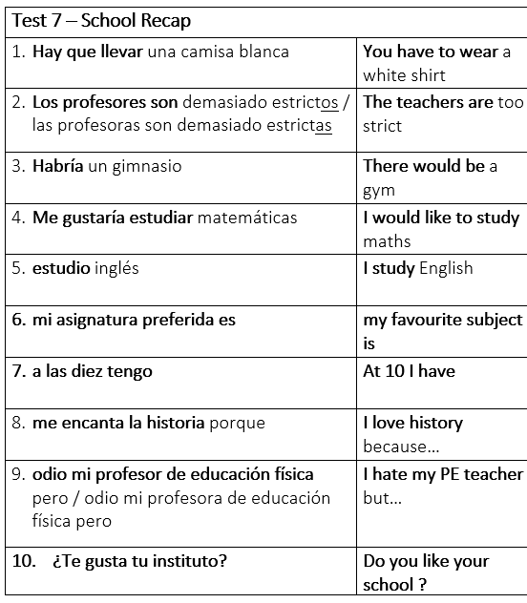
HIGHER
Write numbers 1-10 at the back of your yellow book, then in silence write out the Spanish translations

Slide 21
FOUNDATION
Write numbers 1-10 at the back of your yellow book, then in silence write out the Spanish translations of the words in bold.

Slide 22
ANSWERS
Now swap books with the person next to you and mark their answers.
When you get your book back copy your spellings correctly in green pen.
Write your score on the sheet at the back of your book.
20/20 = house point 16/20 = MFL point Underperforming = Resit at lunch

Slide 23
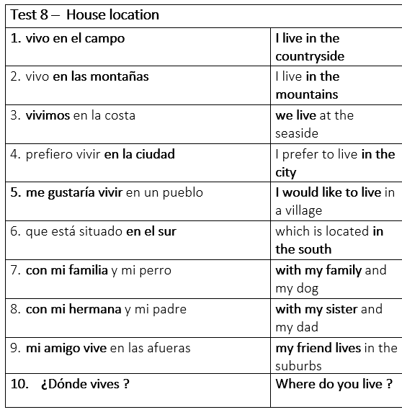
HIGHER
Write numbers 1-10 at the back of your yellow book, then in silence write out the Spanish translations

Slide 24
FOUNDATION
Write numbers 1-10 at the back of your yellow book, then in silence write out the Spanish translations of the words in bold.

Slide 25
ANSWERS
Now swap books with the person next to you and mark their answers.
When you get your book back copy your spellings correctly in green pen.
Write your score on the sheet at the back of your book.
20/20 = house point 16/20 = MFL point Underperforming = Resit at lunch

Slide 26
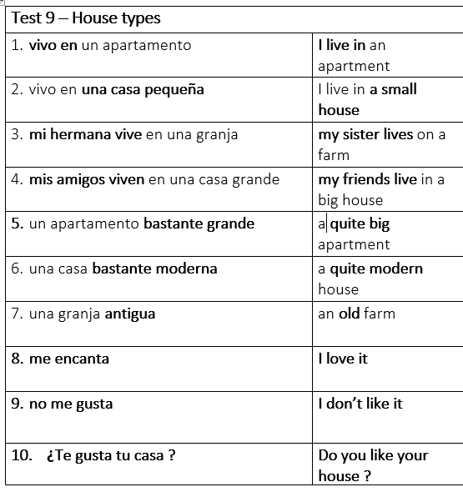
HIGHER
Write numbers 1-10 at the back of your yellow book, then in silence write out the Spanish translations

Slide 27
FOUNDATION
Write numbers 1-10 at the back of your yellow book, then in silence write out the Spanish translations of the words in bold.

Slide 28
ANSWERS
Now swap books with the person next to you and mark their answers.
When you get your book back copy your spellings correctly in green pen.
Write your score on the sheet at the back of your book.
20/20 = house point 16/20 = MFL point Underperforming = Resit at lunch

Slide 29
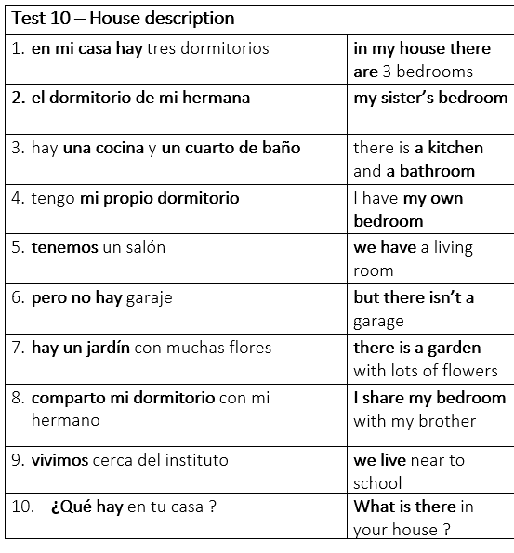
HIGHER
Write numbers 1-10 at the back of your yellow book, then in silence write out the Spanish translations

Slide 30
FOUNDATION
Write numbers 1-10 at the back of your yellow book, then in silence write out the Spanish translations of the words in bold.

Slide 31
ANSWERS
Now swap books with the person next to you and mark their answers.
When you get your book back copy your spellings correctly in green pen.
Write your score on the sheet at the back of your book.
20/20 = house point 16/20 = MFL point Underperforming = Resit at lunch

Slide 32
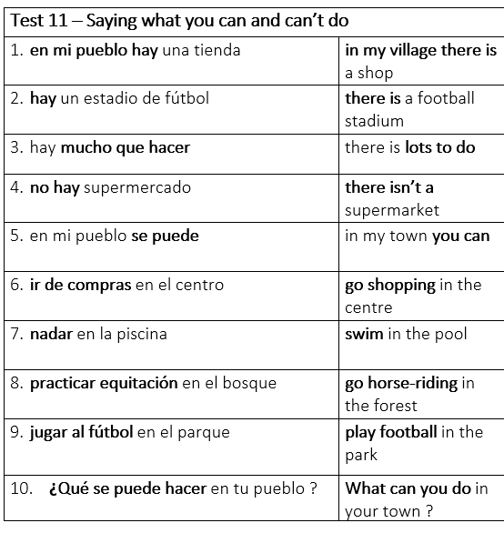
HIGHER
Write numbers 1-10 at the back of your yellow book, then in silence write out the Spanish translations

Slide 33
FOUNDATION
Write numbers 1-10 at the back of your yellow book, then in silence write out the Spanish translations of the words in bold.

Slide 34
ANSWERS
Now swap books with the person next to you and mark their answers.
When you get your book back copy your spellings correctly in green pen.
Write your score on the sheet at the back of your book.
20/20 = house point 16/20 = MFL point Underperforming = Resit at lunch

Slide 35
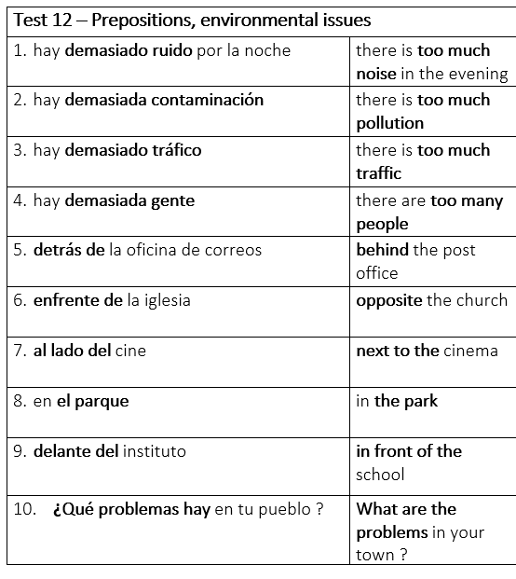
HIGHER
Write numbers 1-10 at the back of your yellow book, then in silence write out the Spanish translations

Slide 36
FOUNDATION
Write numbers 1-10 at the back of your yellow book, then in silence write out the Spanish translations of the words in bold.

Slide 37
ANSWERS
Now swap books with the person next to you and mark their answers.
When you get your book back copy your spellings correctly in green pen.
Write your score on the sheet at the back of your book.
20/20 = house point 16/20 = MFL point Underperforming = Resit at lunch

Slide 38
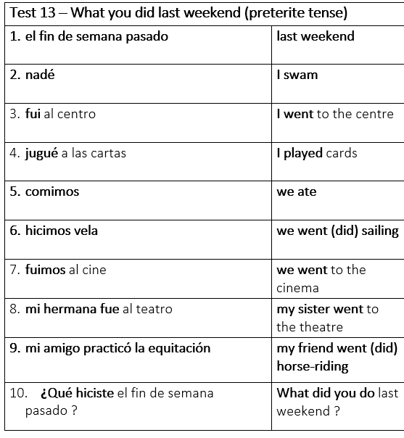
HIGHER
Write numbers 1-10 at the back of your yellow book, then in silence write out the Spanish translations

Slide 39
FOUNDATION
Write numbers 1-10 at the back of your yellow book, then in silence write out the Spanish translations of the words in bold.

Slide 40
ANSWERS
Now swap books with the person next to you and mark their answers.
When you get your book back copy your spellings correctly in green pen.
Write your score on the sheet at the back of your book.
20/20 = house point 16/20 = MFL point Underperforming = Resit at lunch

Slide 41
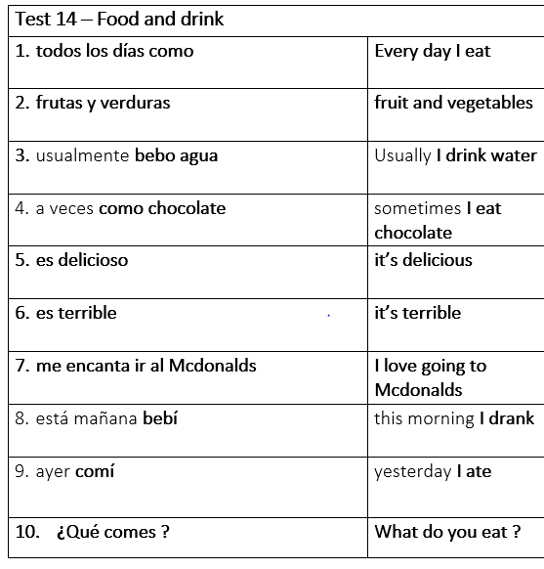
HIGHER
Write numbers 1-10 at the back of your yellow book, then in silence write out the Spanish translations

Slide 42
FOUNDATION
Write numbers 1-10 at the back of your yellow book, then in silence write out the Spanish translations of the words in bold.

Slide 43
ANSWERS
Now swap books with the person next to you and mark their answers.
When you get your book back copy your spellings correctly in green pen.
Write your score on the sheet at the back of your book.
20/20 = house point 16/20 = MFL point Underperforming = Resit at lunch

Slide 44
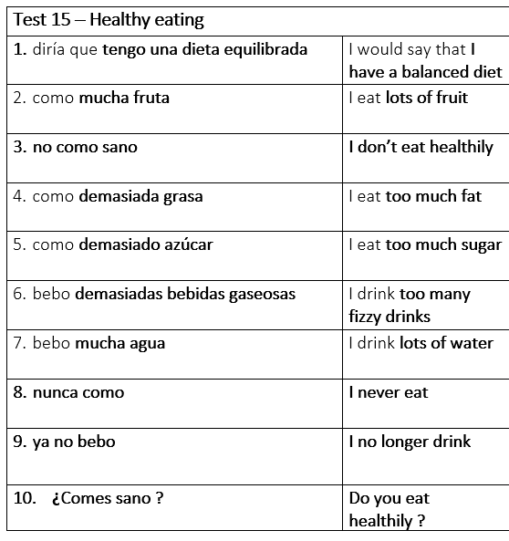
HIGHER
Write numbers 1-10 at the back of your yellow book, then in silence write out the Spanish translations

Slide 45
FOUNDATION
Write numbers 1-10 at the back of your yellow book, then in silence write out the Spanish translations of the words in bold.

Slide 46
ANSWERS
Now swap books with the person next to you and mark their answers.
When you get your book back copy your spellings correctly in green pen.
Write your score on the sheet at the back of your book.
20/20 = house point 16/20 = MFL point Underperforming = Resit at lunch

Slide 47
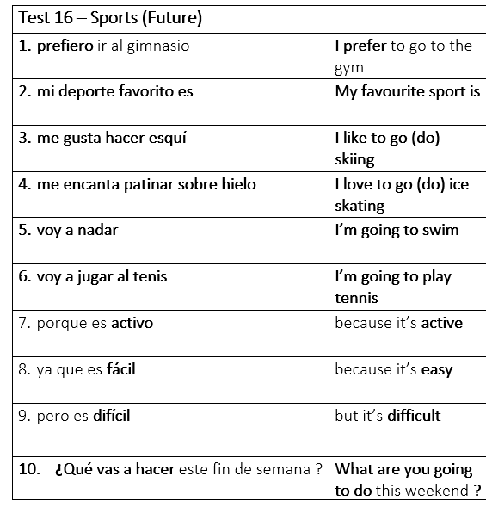
HIGHER
Write numbers 1-10 at the back of your yellow book, then in silence write out the Spanish translations

Slide 48
FOUNDATION
Write numbers 1-10 at the back of your yellow book, then in silence write out the Spanish translations of the words in bold.

Slide 49
ANSWERS
Now swap books with the person next to you and mark their answers.
When you get your book back copy your spellings correctly in green pen.
Write your score on the sheet at the back of your book.
20/20 = house point 16/20 = MFL point Underperforming = Resit at lunch

Slide 50
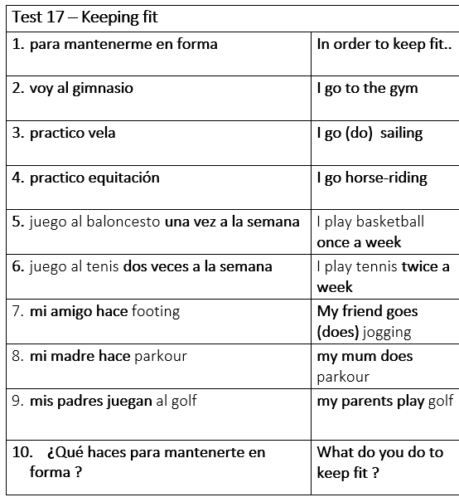
HIGHER
Write numbers 1-10 at the back of your yellow book, then in silence write out the Spanish translations

Slide 51
FOUNDATION
Write numbers 1-10 at the back of your yellow book, then in silence write out the Spanish translations of the words in bold.

Slide 52
ANSWERS
Now swap books with the person next to you and mark their answers.
When you get your book back copy your spellings correctly in green pen.
Write your score on the sheet at the back of your book.
20/20 = house point 16/20 = MFL point Underperforming = Resit at lunch

Slide 53
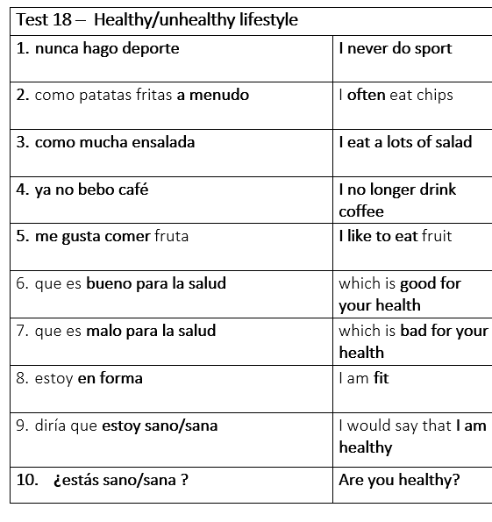
HIGHER
Write numbers 1-10 at the back of your yellow book, then in silence write out the Spanish translations

Slide 54
FOUNDATION
Write numbers 1-10 at the back of your yellow book, then in silence write out the Spanish translations of the words in bold.

Slide 55
ANSWERS
Now swap books with the person next to you and mark their answers.
When you get your book back copy your spellings correctly in green pen.
Write your score on the sheet at the back of your book.
20/20 = house point 16/20 = MFL point Underperforming = Resit at lunch

Slide 56
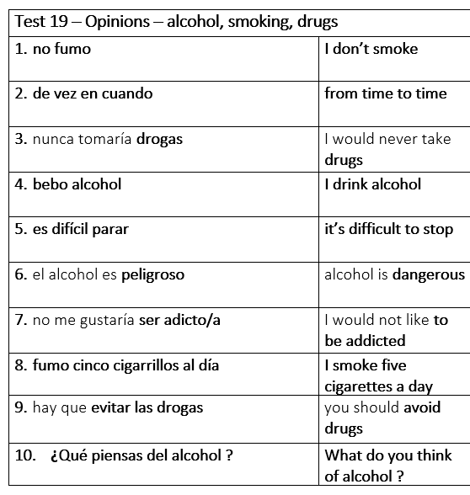
HIGHER
Write numbers 1-10 at the back of your yellow book, then in silence write out the Spanish translations

Slide 57
FOUNDATION
Write numbers 1-10 at the back of your yellow book, then in silence write out the Spanish translations of the words in bold.

Slide 58
ANSWERS
Now swap books with the person next to you and mark their answers.
When you get your book back copy your spellings correctly in green pen.
Write your score on the sheet at the back of your book.
20/20 = house point 16/20 = MFL point Underperforming = Resit at lunch

Slide 59
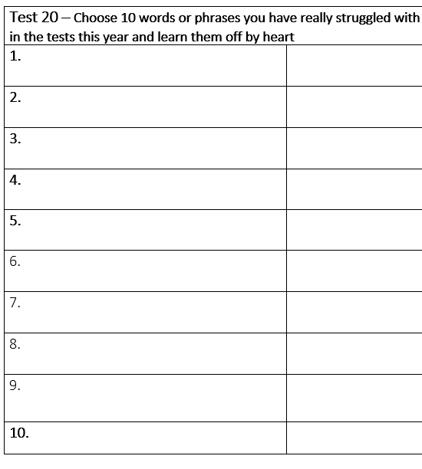
HIGHER
Write numbers 1-10 at the back of your yellow book, then in silence write out the Spanish translations

Slide 60
FOUNDATION
Write numbers 1-10 at the back of your yellow book, then in silence write out the Spanish translations of the words in bold.

Slide 61
ANSWERS
Now swap books with the person next to you and mark their answers.
When you get your book back copy your spellings correctly in green pen.
Write your score on the sheet at the back of your book.
20/20 = house point 16/20 = MFL point Underperforming = Resit at lunch

