Slide 1
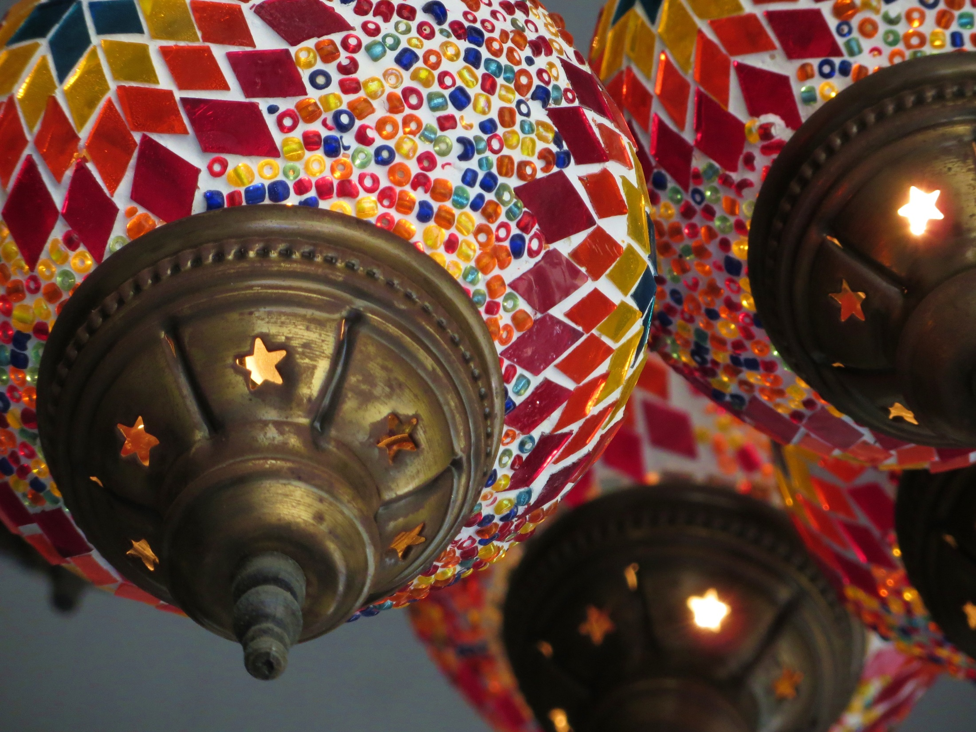
PARA EMPEZAR (STARTER):
Try to think of the answers to the following questions. Use your notes from last week if you have to…
What is the difference between the future tense and the near future tense?
How do we form the future tense?
How do we form the near future tense?
Give 3 examples of each.

Slide 2
El Condicional
martes el 3 de marzo
Objetivo: To learn how to form the conditional tense and say what you would change about your school
Powtoon tutorial

Slide 3
The Conditional Tense:
We use it when we are talking about something that would, should or could happen in the future.
For example:
I would like to go to a school with less rules.
My ideal school wouldn’t have teachers.
If I had the choice I would prefer to go to a school without uniform.
For example:
Teachers should be less strict.
Pupils should work harder.
The uniform should be more colourful.

Slide 4
The Conditional Tense:
Take the infinitive.
e.g comer – to eat
comería – I would eat
Then add the following endings:
I | ía
You (s.) | ías
He/She/One | ía
We | íamos
You (pl) | íais
They | ían

Slide 5
The Conditional Tense:
EXAMPLES
I would speak – hablaría
You would eat - comerías
He would visit – visitaría
We would be – seríamos
You (pl.) would go - iríais
They would play - jugarían

Slide 6
The Conditional Tense:
IRREGULARS
Add the correct ending to the following irregular stems :
(to say) decir → dir
(to do) hacer → har
(to be able to) poder → podr
(to want) querer → querr
(to know) saber → sabr
(to leave) salir → saldr
(to have) tener → tendr
(to come) venir → vendr
(there is/are) haber → habr

Slide 7
The Conditional Tense:
Listen to the Beyonce song and note down any examples of the conditional you can hear/see.

Slide 8
The Conditional Tense:
¿Qué significa…?
cambiaría
tendría
sería
I would change
would have
would be

Slide 9
The Conditional Tense:
Vocabulario Importante:
Si fuera el director – If I were the headteacher
Si tuviera la oportunidad – If I had the opportunity
En mi instituto ideal – In my ideal school
habría – there would be
se podría – you would be able to

Slide 11
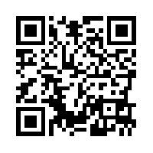
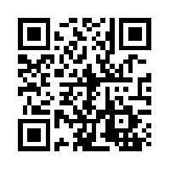
The Conditional Tense:
Still not sure how to form the conditional tense?
Scan one of these on your way out:

